Slide 1
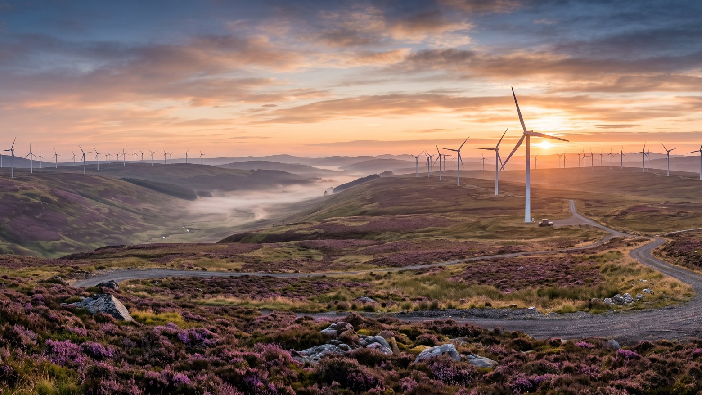
WEYLAND ENERGY
Marketing & Communications plan 2026
Leadership meeting, 12 December 2025

Slide 2
“The year we show we can build – and find the people to do it.”
— Noah Fischer
WEYLAND ENERGY · Marketing & Communications plan 2026
2

Slide 3
Priorities
• Harrow Bay milestones: FID, first monopile, substation
• Employer brand campaign (later: Powering the North)
• Millbrook – support the planning process, no paid media
• North Sea Energy Summit in Hamburg, September
• Website relaunch by June
WEYLAND ENERGY · Marketing & Communications plan 2026
3

Slide 4
Budget 2026
€633k
38 %
29 %
4
total budget
employer campaign
summit
FTE + agency
WEYLAND ENERGY · Marketing & Communications plan 2026
4

Slide 5
Team
• Noah Fischer – lead, press
• Leah Goldberg – content & social
• Ravi Shah – design, photo, video
• Agency: Fjord & Harbour Creative (campaign), freelance photographers
WEYLAND ENERGY · Marketing & Communications plan 2026
5

Slide 6
WEYLAND ENERGY
Clean power, built to last.

